Slide 1
Welcome
A Guide to Implementing
Best Practices
across a
MTSS
Thank you for your work to bring more joy to students’ lives!
Dec. 16, 2024

Slide 2
4th Quarter Multi State Collaborative Meeting
The Multi State Collaborative, organized by mdlogix, home of the bhworks student mental health software system, was established in spring 2022 to enable those working to prevent, treat, and solve youth behavioral and mental health issues to collectively share best practices across states.
The collaborative meets every quarter (invitation only) for one hour on pressing topics chosen by the group. Its web page is
https://mdlogix.com/community/

Slide 3
The Bigger Picture: Improve Mental Health & Save Lives
Share resources for grants and other funding source/availability (Project AWARE; GLS; etc.)
Share resources for grants and other funding source/availability (Project AWARE; GLS; etc.)
Share Best Practices in: Referral; Screening & Assessments; Safety Planning; Care Management/Coordination; Billing; Reporting
bhworks software platform as the integrated technology infrastructure
Share resources for grants and other funding source/availability (Project AWARE; GLS; etc.)
Share national policy and leading evidence-based trainings

Slide 4
16 States Represented Today
Arizona
Arkansas
California
Colorado
Delaware
Georgia
Hawaii
Maryland
Michigan
Minnesota
Nevada
New Jersey
New York
Ohio
Pennsylvania
Vermont

Slide 5
Tell Us Who You Are
In the chat, please put your name, organization, and state
Share with your colleagues what you are
doing right! Others could adapt it.
During the presentations please put
your questions in the chat and we will
make sure they are addressed.
We will also have time for discussion,
comments, and questions.

Slide 6
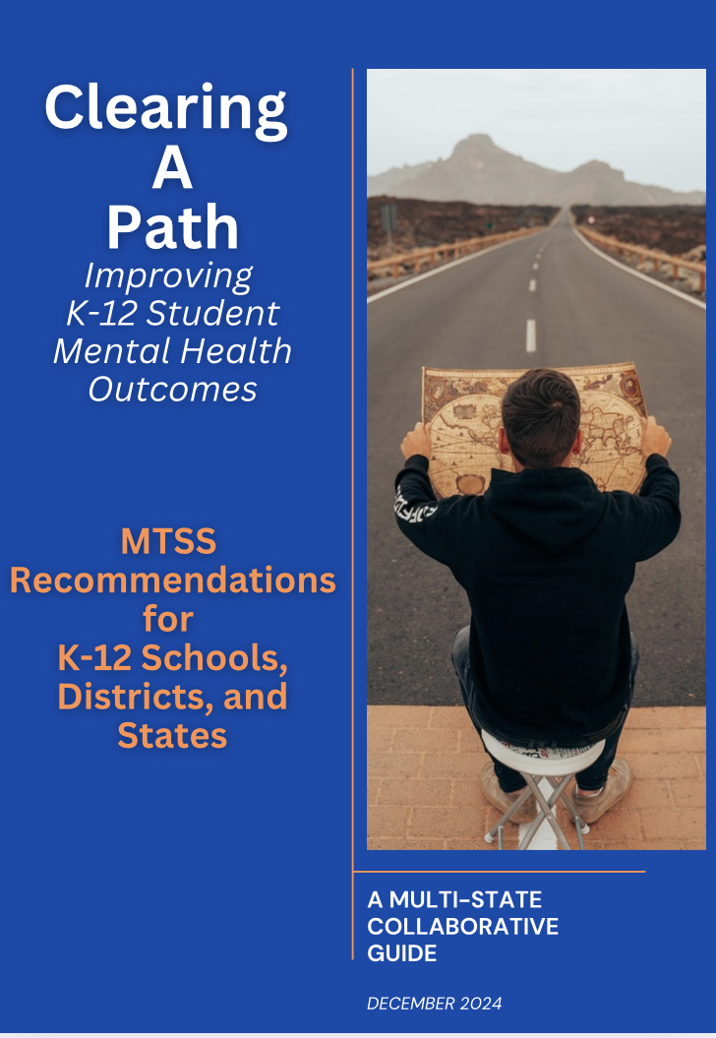
12-page guide with 6 state leaders
Emailed to participants last week
Email marjoriem@mdlogix.com if you didn’t receive it

Slide 7
Speakers
Dana Walburn, LCSW
Behavioral Health Program Manager
bhworks software
Kaci Fleetwood, M.Ed, BCBA, LBA
State Coordinator for MTSS, University of Nevada/Reno
Principal Investigator, Nevada's Positive Behavioral Interventions and Supports (PBIS) Technical Assistance Center

Slide 8
Questions, Discussion,
Share Experiences

Slide 10
Wrap Up
Meeting follow-up: You will receive the speaker slides and a link to the video recording as well as to the Multi State Collaborative web landing page
First Quarter 2025 Collaborative topic, date, and time TBD in late January.

Slide 11
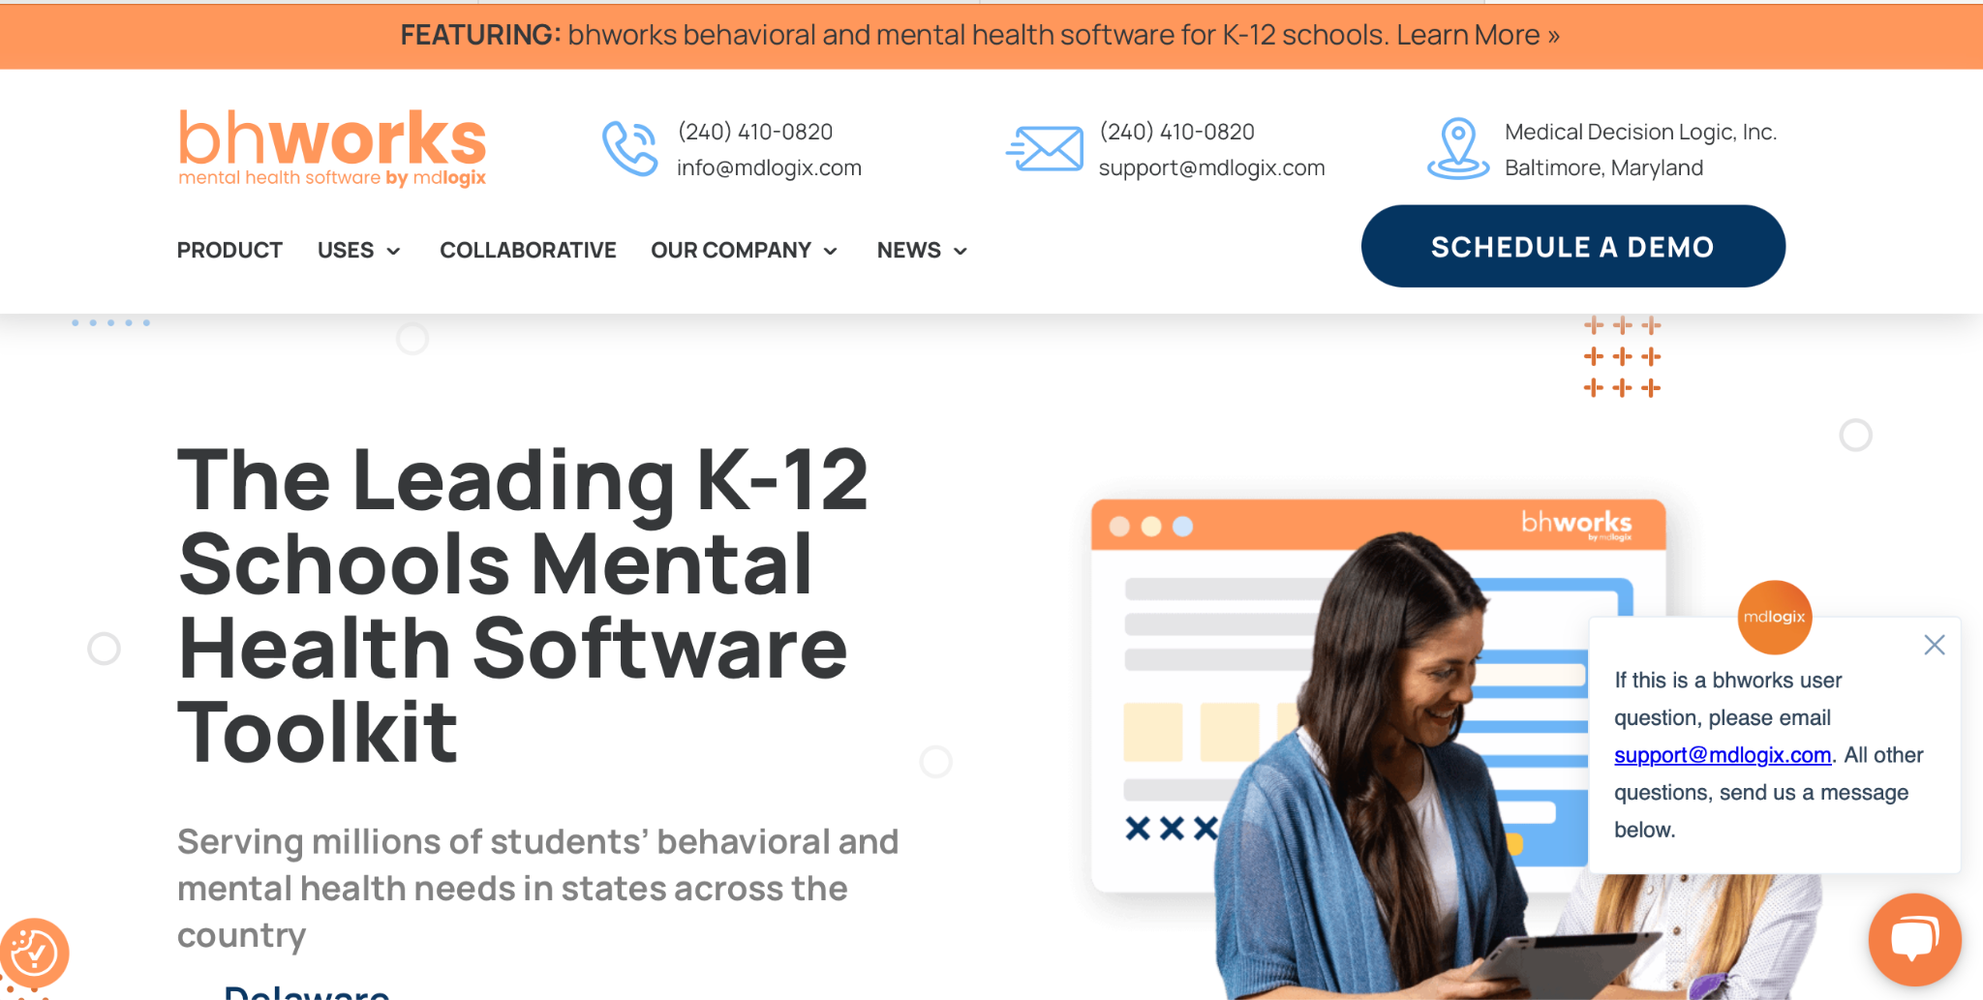
mdlogix.com

Slide 12
Team bhworks
Dana Walburn, LCSW, Behavioral Health Program Manager, dwalburn@mdlogix.com or 775-742-0040
Marjorie McKee, VP, marketing and communications
marjoriem@mdlogix.com or 571-253-0567
Website: mdlogix.com, with “Collaborative” page and “Schedule a Demo”
LinkedIn: mdlogix
Facebook: mdlogix

